Slide 1



CONSUMER GOODS AD-HOC INSIGHTS
tliq Hardwares
Presented by Waqas Ahmad

Slide 2
OUTLINE
BACKGROUND
UNDERSTANDING ATLIQ’S BUSINESS
Market Presence and Product Portfolio
3. DATA FAMILIARIZATION
Overview of Input Data
4. AD-HOC INSIGHTS
Requests Queried Results, Visualizations, and Insights

Slide 3
Our Company
AtliQ Hardwares
As a premier computer hardware manufacturer in India, AtliQ Hardwares is renowned for its high-quality products and market leadership.
Background
Our management has identified a critical gap: a lack of timely and insightful data to facilitate swift, informed decision-making.
Challenge
We face ten specific ad-hoc inquiries that require detailed analysis and insights.
Strategy
To address this, we will execute SQL queries to obtain the necessary data, transform these findings into visual representations, and deliver comprehensive insights to our executive team.
1.
BACKGROUND

Slide 4
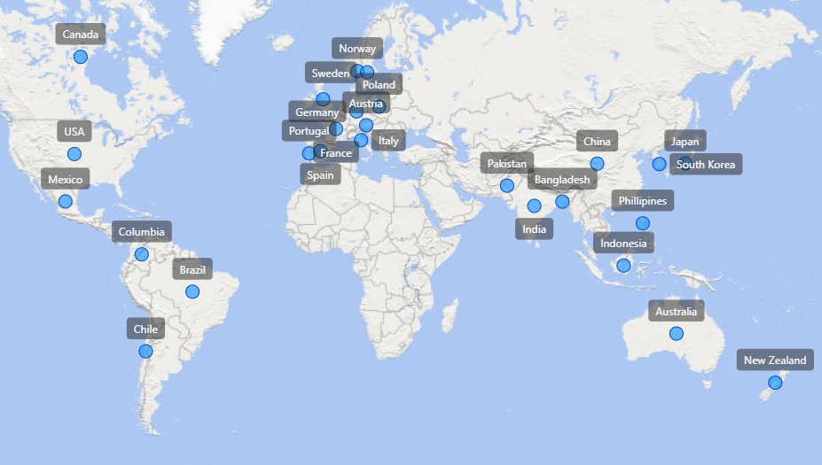
2. UNDERSTANDING
ATLIQ’S BUSINESS
AtliQ’s Markets
Market Presence and Product Portfolio

Slide 5
AtliQ’s Product Portfolio
PC
P&A
N&S
Desktop
Notebook
Peripherals
Accessories
Networking
Storage
Business
Laptop
Gaming
Laptop
Graphic Card
Batteries
External
SSD
WiFi
Extender
Internal HDD
Keyboard
USB Flash Drives
Personal
Laptop
Business
Laptop
Mother Board
Mouse
Personal
Laptop
Processors

Slide 6
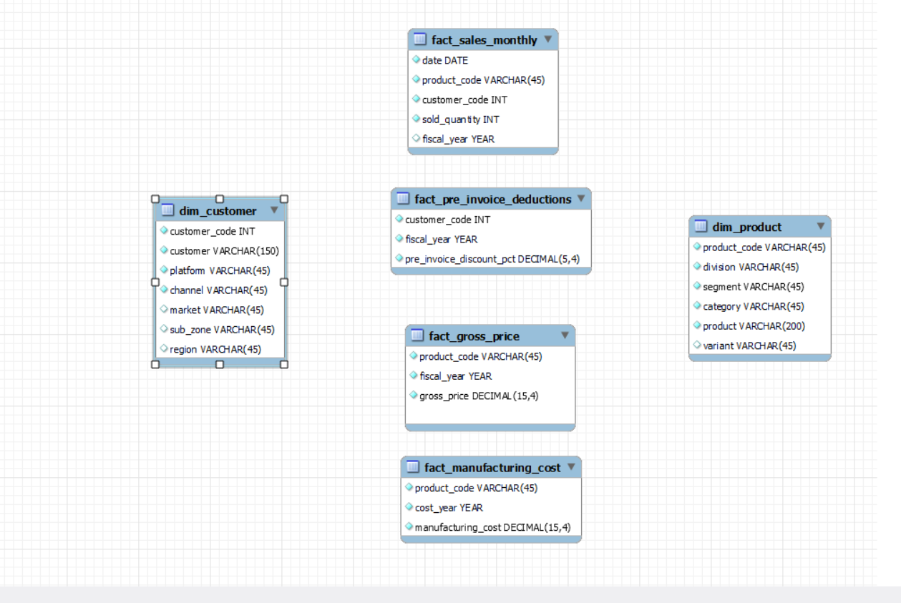
3.
DATA FAMILIARIZATION
The input data includes sales records for FY 2020 and FY 2021, along with various dimension tables such as customer details, product details, and others.

Slide 7




This Photo by Unknown Author is licensed under CC BY-ND
4.
AD-HOC INSIGHTS
Requests, Queried Results, Visualizations, and Insights

Slide 8
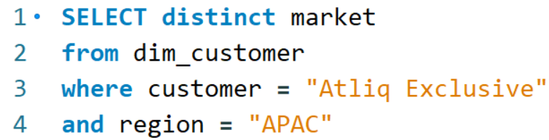
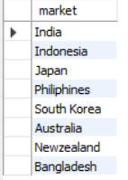
REQUEST 1:
Provide the list of markets in which customer "Atliq Exclusive" operates
its business in the APAC region.
Query :
Output :

Slide 9
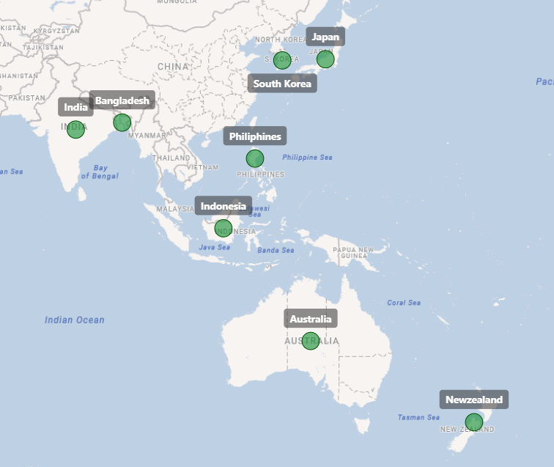
Insight :
In the APAC region, Atliq’s Exclusive store has established its presence in 8 major markets

Slide 10
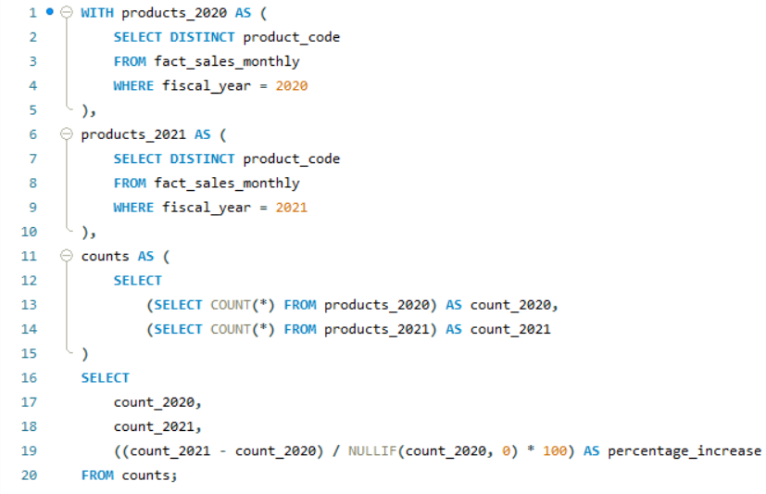
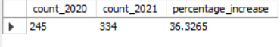
REQUEST 2:
What is the percentage of unique product increase in 2021 vs. 2020?
The final output contains these fields, unique_products_2020 unique_products_2021 percentage_chg
Query :
Output :

Slide 11
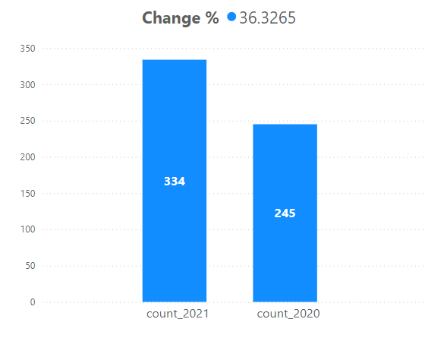
Insight :
The visual highlights a remarkable 36.33% increase in unique products, rising from 245 in 2020
to 334 in 2021, showcasing our successful expansion and enhanced product diversity.

Slide 12
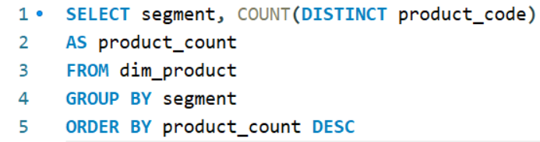
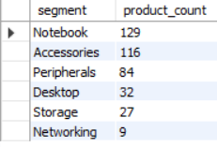
REQUEST 3:
Provide a report with all the unique product counts for each segment and sort them in descending order of product counts.
The final output contains 2 fields, segment product_count
Query :
Output :

Slide 13
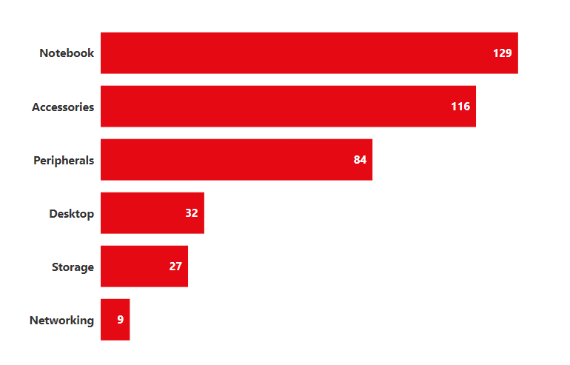


Insight :
- Growth Trends: The manufacturing segments for notebooks, accessories, and peripherals are experiencing substantial growth compared to those for desktops, storage, and networking.
- Dominant Segments: Notebooks, accessories, and peripherals together account for 83% of our total manufactured products, highlighting their dominant position in our production portfolio.
83%
17%

Slide 14
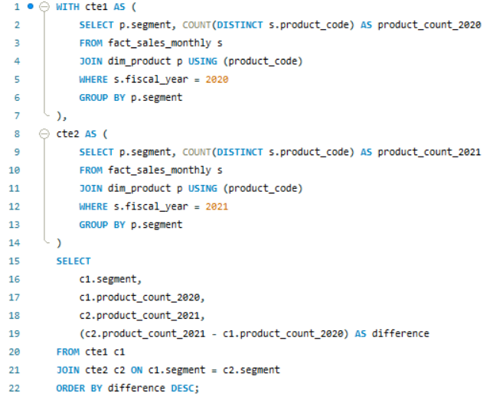
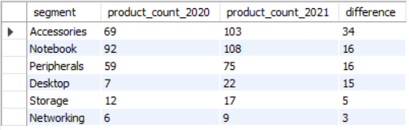
REQUEST 4:
Follow-up: Which segment had the most increase in unique products in 2021 vs 2020?
The final output contains these fields, segment product_count_2020 product_count_2021 difference
Query :
Output :

Slide 15
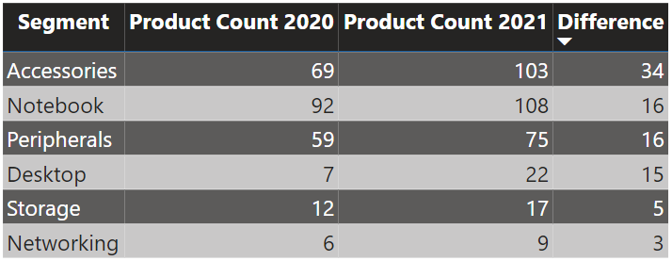
Insight :
Accessories saw the biggest jump in production, up by 34 units!
Storage and networking are growing slower, with just 5 and 3 more units produced respectively.

Slide 16
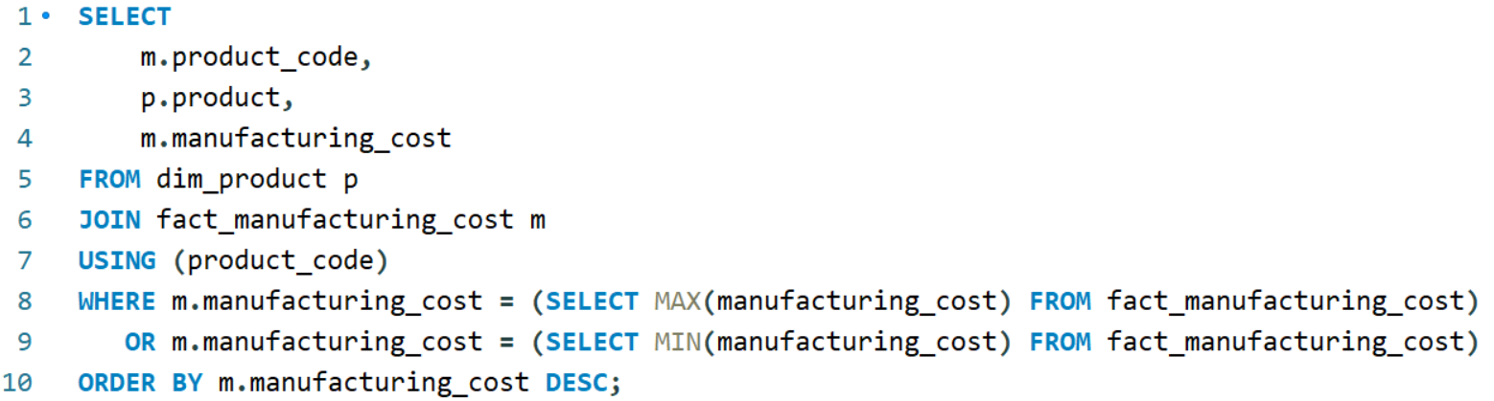
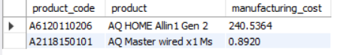
REQUEST 5:
Get the products that have the highest and lowest manufacturing costs. The final output should contain these fields, product_code product manufacturing_cost
Query :
Output :

Slide 17
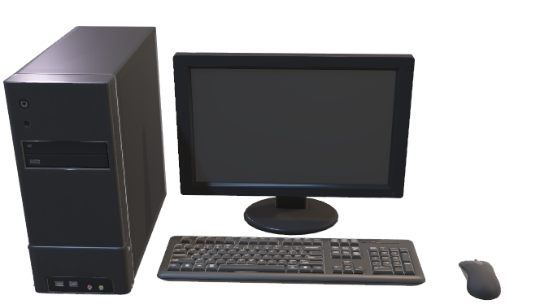

Insight :
Product with
HIGHEST MANUFACTURING COST
Product with
LOWEST MANUFACTURING COST
$ 240.54
$ 0.89
AQ HOME Allin1 Gen 2 (Plus 3)
Personal Desktop
AQ Master Wired x1 Ms
(Standard 1)

Slide 18
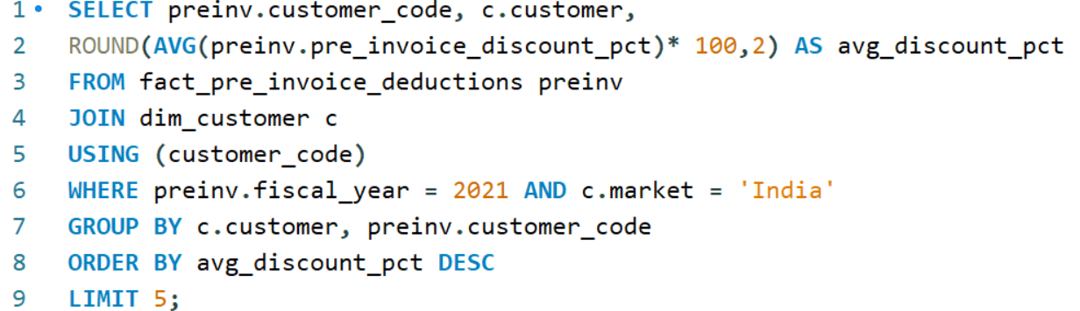
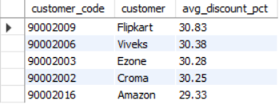
REQUEST 6:
Generate a report which contains the top 5 customers who received an average high pre_invoice_discount_pct for the fiscal year 2021 and in the Indian market.
The final output contains these fields, customer_code customer average_discount_percentage
Query :
Output :

Slide 19
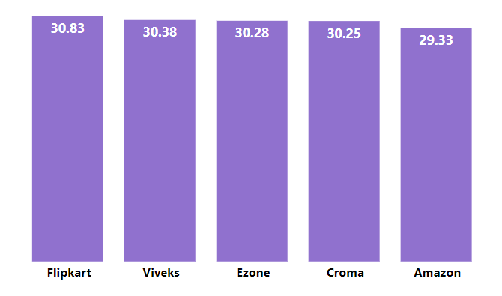
Insight :
Top 5 Indian customers
with highest average discount percentage for FY 2021
%
%
%
%
%
Customer

Slide 20
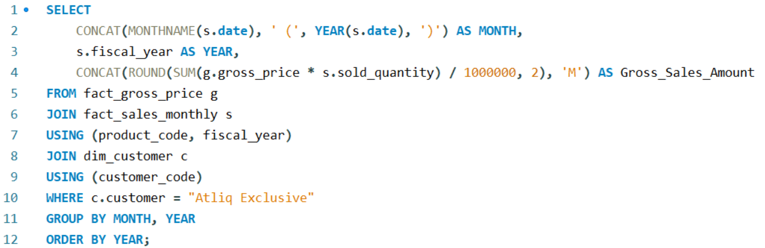
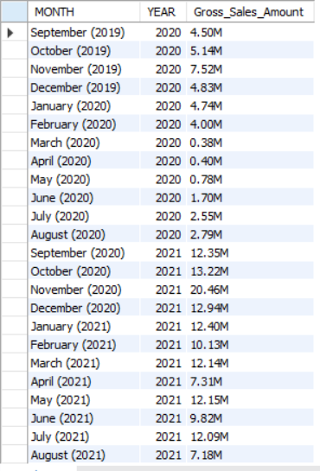
REQUEST 7:
Get the complete report of the Gross sales amount for the customer
“Atliq Exclusive” for each month.
This analysis helps to get an idea of low and high-performing months and take strategic decisions. The final report contains these columns:
Month, Year, Gross sales Amount
Query :
Output :

Slide 21
Insight :
→ Peak Sales: AtliQ Exclusive experienced its highest sales in November 2020
→ Lowest Sales: March 2020 recorded the lowest sales figures
→ Impact of COVID-19: The decline in sales from March to August 2020 was attributed to the repercussions of the COVID-19 pandemic.
→ Recovery and Resilience: Sales have steadily rebounded after the pandemic, showcasing resilience and surpassing the levels observed in 2020

Slide 22
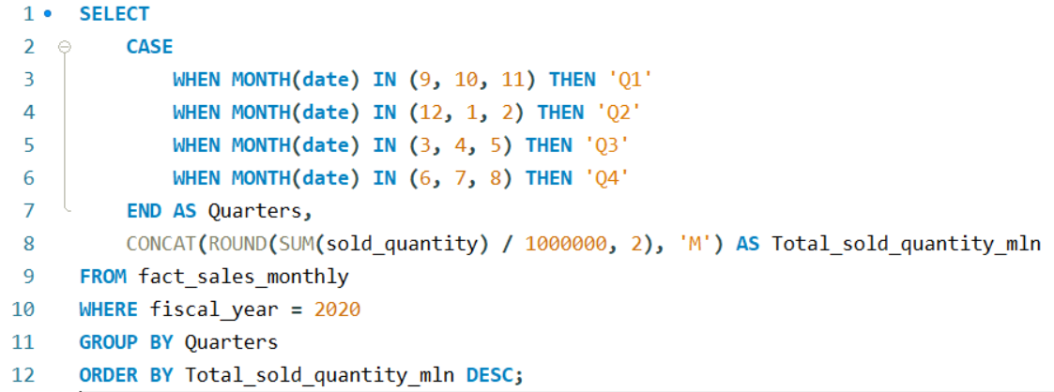
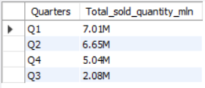
REQUEST 8:
In which quarter of 2020, got the maximum total_sold_quantity?
The final output contains these fields sorted by the total_sold_quantity, Quarter total_sold_quantity
Query :
Output :

Slide 23
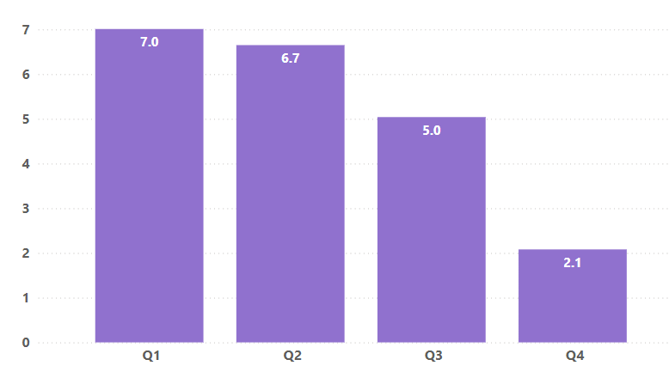
Insight :
This complements the previous insight regarding the impact of COVID-19 on our sales.
The sold quantity dropped to 2.1 million units in Q3 of FY 2020, encompassing March, April, and May, when the pandemic was at its peak.
However, we began to recover quite early, even as the pandemic continued. This early recovery in Q4 can likely be attributed to the increased demand for hardware such as desktops and notebooks, as many students started or continued their coursework online. This period saw a significant surge in demand for computer accessories.
Sold Quantity in Millions →
Q4
Q3
Quarters →

Slide 24
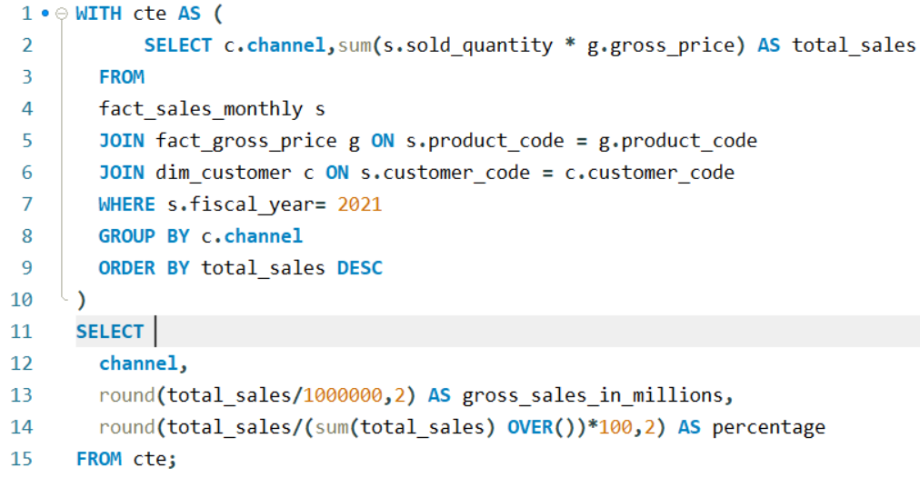
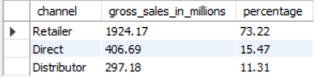
REQUEST 9:
Which channel helped to bring more gross sales in the fiscal year 2021 and the percentage of contribution?
The final output contains these fields, channel gross_sales_mln percentage
Query :
Output :

Slide 25
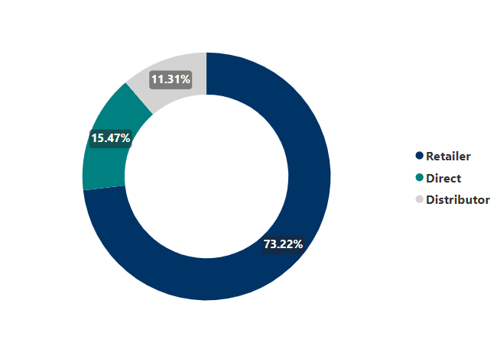
Insight :
The majority of our sales, 75% of the total, were made through retailers.
Only a small percentage occurred through direct and distributor channels.

Slide 26
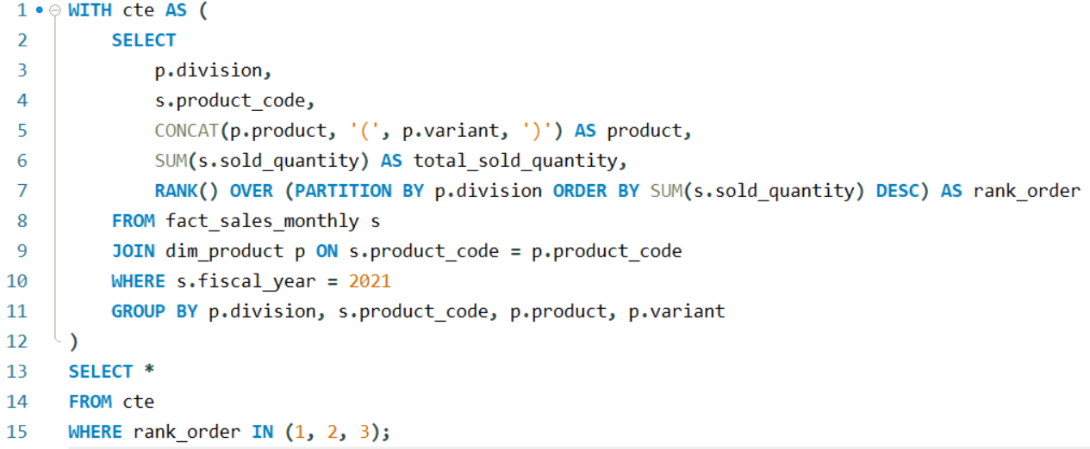
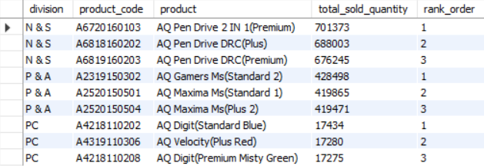
REQUEST 10:
Get the Top 3 products in each division that have a high total_sold_quantity in the fiscal_year 2021?
The final output contains these fields, division, product_code
Query :
Output :

Slide 27
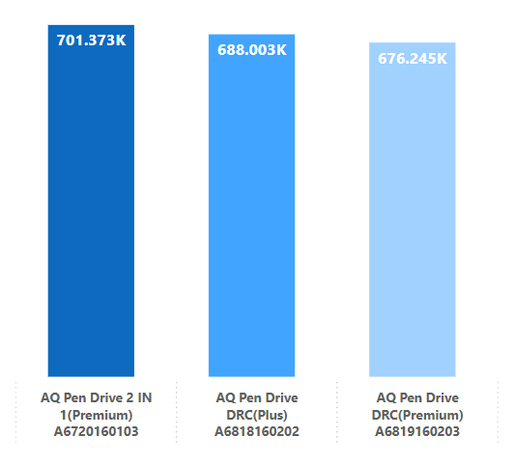
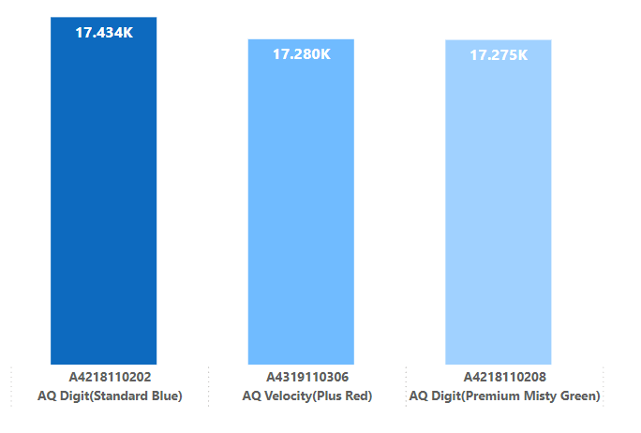



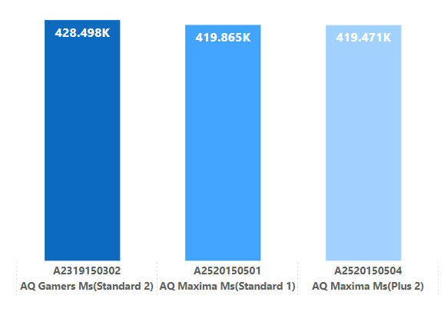
Insight :
Division : N & S
Division : PC
Division : P & A

Slide 28
END
THANK YOU

